Slide 1

Dart
a very quick introduction
https://github.com/bseib/LightningishDart
google.com/+BrocSeib
broc.seib@gmail.com
GLOSSY lightning-ish talks
Apr. 26, 2014

Slide 2
What is Dart?
A programing language, developed by Google.
It runs client side in web browsers.
It can also run on server side.
Notes:
There is dart2js compiler, and there is DartVM. DartVM will eventually make its way into mainstream Chrome. DartVM also big help for instant feedback in during development.
Can run server-side in DartVM. There is also mod_dart for Apache.
Influences from many langs, like Smalltalk, Strongtalk, Erlang, C#, and JavaScript.
Great details about the language: Search for videos by Gilad Bracha on Dart language.

Slide 3
Why Dart?
Do we need yet another language?
Large scale javascript development stinks.
You already know Dart.
(Pretty much anyway.)
Notes:
Yet another language!? Why?! Because the biggest client-side platform is the web browser, and programming for it stinks. Just consider data types alone. When your code gets big enough to modularize and you create "API contracts", you really need data types. Look at gmail as an example of a large scale client side app.
(Note: Dart catches type assignment problems only in "checked mode", which is on by default in development. Kinda like erasures in Java.)
Ever seen slide decks just on the topic of "surprises" in Javascript? There are too many pitfalls and gotchas when writing code for web clients. E.g., count the number of ways a value can be interpreted as boolean false in js: false, null, undefined, "", 0, NaN.
Dart as a language is designed to be familiar and comfortable for the common programmer. This does not mean we are dumb programmers. It means Good Design, akin to Josh Bloch's thoughts on having a Good API. (Search: How To Design A Good API and Why it Matters - by Josh Bloch)
I don't think Dart is simply raising the bar higher than Javascript (which is pretty low) -- it's not just another compile-to-js solution. Thought and care are put into the language with consideration to the larger picture. Examples: slimmer distribution size (mirror API), adaptation (dart2js), minification (symbols), the development experience as a whole (types, etc).

Slide 4
The usual suspects
Control Flow
while() {}
do {} while()
if () {} else {}
for ( ; ; )
for ( x in list )
switch case
Exception Handling
try {} catch() {} finally {}
throw
Classes
class Foo {
String name;
void printName() {
print(name);
}
}
Built-in Types
double, int, num,
bool, String
Notes:
There's a lot of Dart that you've already seen in other languages, so no point in diving into what is already well understood.
flow control
loops
built-in types, objects, generics
only boolean 'true' means true. everything else is false.
classes
exception handling
class libraries
strings, dates, collections, io, net, crypto, html, ...

Slide 5
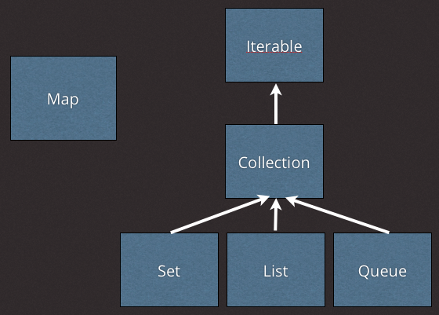
Collections
Map, Set, List, Queue
image source:
Seth Ladd's Dart tips
Literal assignments are supported:
var colors = ["red", "blue", "green"];
var histogram = { 'oak': 12, 'ash' : 34 };
Notes:
collections1.dart
In addition to the "usual suspects" are some basic building blocks for data structures.
Maybe have a look at this for starters: https://www.dartlang.org/dart-tips/dart-tips-ep-5.html
Code examples for each one would be too long for this talk.
So let's talk about the aspects of Dart that stand out compared to other languages...

Slide 6
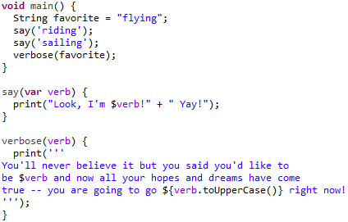
What does Dart look like?
Notes:
sample1.dart
* entry point is top level function main(). note that return type "void" is not mandatory.
* optional types
* strings with single or double quotes
* string interpolation, with expressions
* string concatenation
* multi-line strings
Live code demo: Ok folks, let's change some types and find where it breaks the code.
e.g., alter 'verbose()' arg type vs. alter type for 'favorite' variable

Slide 7
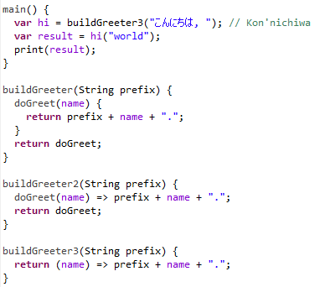
Closures, fn => shorthand
=> expr
is shorthand for
{ return expr; }
Notes:
function1.dart
show a closure
show => shorthand
=> expr
is shorthand for
{ return expr; }

Slide 8
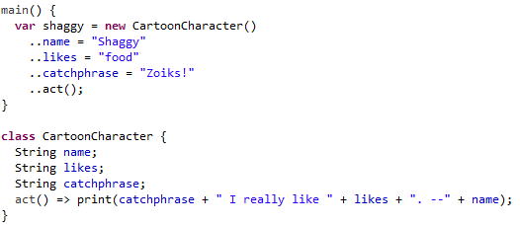
Cascade operator ..
Notes:
cascade1.dart
The cascade operator .. allows you to perform multiple operations on the same object.
function type?
default arguments in fn call
private variable
collections, generics

Slide 9
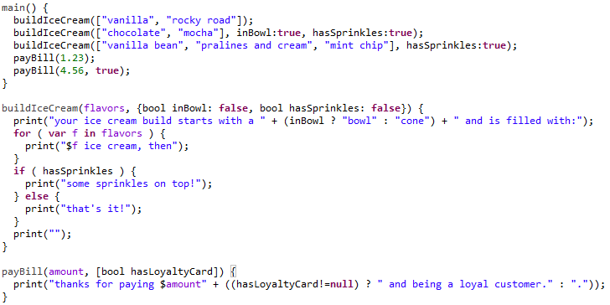
Optional parameters
Notes:
parameters1.dart
named parameters: you specify their presence by name. You can omit params and specify defaults when absent.
ordered parameters: the order of arguments dictates their presence. They are null when absent.

Slide 10
Generics
var colors = new List<String>();
colors.addAll(['Red', 'Blue', 'Green']);
colors.add(123); // fails in checked mode
var map = new Map<String, bool>();
// ...
class Cache<T> {
T getByKey(String key);
setByKey(String key, T value);
}
Notes:
Yes, generics pretty much work exactly like you'd expect.
Note that types are only enforced in checked mode.

Slide 11
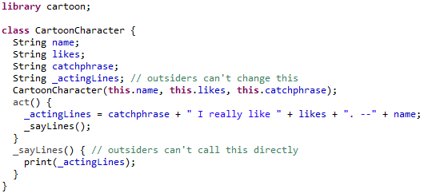
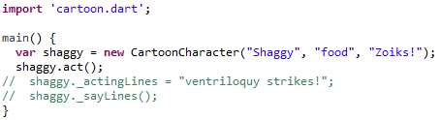
Private variables
Notes:
private1.dart
Only two levels: "public" and "private". It is implemented by naming convention. Class variables and methods are private when you prefix them with an underscore.
Also note that you can only have privacy at a library level, not at object level. Read some discussion by Bob Nystrom and Ben Laurie here: https://groups.google.com/a/dartlang.org/d/topic/misc/WllRrg0zTd4/discussion

Slide 12
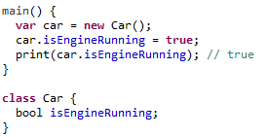
Getters and Setters
Notes:
Example is directly from: https://www.dartlang.org/dart-tips/dart-tips-ep-10.html
The big deal here is that we avoid all the boilerplate getter/setter code like you might see in java.
Assignment to and reading from a member variable with = is the setter and getter functions respectively.
However, you can override the default by writing a getter or setter.
But wait... why was all that getter/setter boilerplate stuff important to start with? Well, the idea is that you gain encapsulation by using getters and setters, that you don't expose the inner state of your object to the outside world. But there is no reason for encapsulation to be mandatory. Use cases like data transfer objects are a good example where you just want to transport a organized record of information and there is never any related code to act upon it in an object oriented manner.

Slide 13
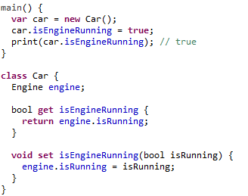
Getters and Setters
Notes:
Example is directly from: https://www.dartlang.org/dart-tips/dart-tips-ep-10.html
The big deal here is that we avoid all the boilerplate getter/setter code like you might see in java.
Assignment to and reading from a member variable with = is the setter and getter functions respectively.
However, you can override the default by writing a getter or setter.
But wait... why was all that getter/setter boilerplate stuff important to start with? Well, the idea is that you gain encapsulation by using getters and setters, that you don't expose the inner state of your object to the outside world. But there is no reason for encapsulation to be mandatory. Use cases like data transfer objects are a good example where you just want to transport a organized record of information and there is never any related code to act upon it in an object oriented manner.

Slide 14
Mixins
A la carte inheritance. Pick what you want.
// Wings is a mixin
// FlyingPig is called a mixin application
abstract class FlyingPig = Pig with Wings;
A class declaration + convention makes a mixin.
no constructor
super class is Object
never call super()
Notes:
The idea here is that the code in Wings can be shared in lots of places without forcing it to be declared in a particular class hierarchy.
A mixin class "has no inheritance", since it is meant to be bolted "onto the side".
Q: So what do you think the restrictions are for creating a mixin class? A: -- don't extend another class (and never call a super), -- don't have a constructor (we don't know what class we're going to be bolted onto and what their constructor would demand…)
Directly from the Dart language specification:
Mixin Application
A mixin may be applied to a superclass, yielding a new class. Mixin application occurs when a mixin is mixed into a class declaration via its with clause. The mixin application may be used to extend a class; alternately, a class may be defined as a mixin application as described in this section.

Slide 15
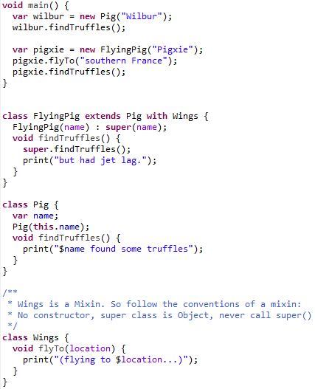
Mixin Example
Notes:
Wings is a mixin class. It extends no other class, never calls super(), and has no constructor.

Slide 16
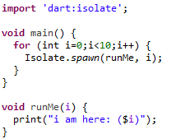
Isolates
Dart is single threaded
Concurrent tasks have private, isolated memory
Notes:
If Dart is "single threaded", how do I do work "in parallel"? (The correct term here is "concurrent". Search for Rob Pike on the topic in golang.)
Dart uses Isolates, in dart:isolate lib. Each isolate has its own course of execution, and its own stack. Isolates cannot access each other's memory. You must use message passing to share state information. You invoke spawnFunction() or spawnUri() to create an isolate.
**Note that the code snippet does not gather the returned Future objects and wait for their termination! The example is to convey the concept. Also, in a browser spawnUri() must be used rather than spawn().
Directly from the Dart language specification:
Concurrency
Dart code is always single threaded. There is no shared-state concurrency in Dart. Concurrency is supported via actor-like entities called isolates. An isolate is a unit of concurrency. It has its own memory and its own thread of control. Isolates communicate by message passing. No mutable state is ever shared between isolates. Isolates are created by spawning.

Slide 17
Mirror reflection
Classic OO way to do reflection:
o.getClass().getMethods();
Mirror way to do reflection:
reflect(o).type.declarations;
Notes:
Mirrors 2004 paper by Gilad Bracha et al.
Mirrors are objects that reflect other objects.
Good for code distribution, deployment, security. Deployment to web browser is the big deal here.
If you don't have mirrors, then you can't do any of this (good for security). And you are also not deploying all the extra code to the browser.
tree-shaking -- remove the unused code.
reflection vs. tree-shaking.
need to optimize code. but can't if doing reflection.
use of annotations to mark things to keep around.
reflection vs. minification
reflect(MyClass).declaration[someMethod]
the symbols get mangled.
Symbols to rescue.
reflect(MyClass).declaration[#someMethod]
to get one: new Symbol(s);
this helps us partially defeat minification.
Mirrors Caveat Emptor: work-in-progress. coming to dart2js soon.

Slide 18
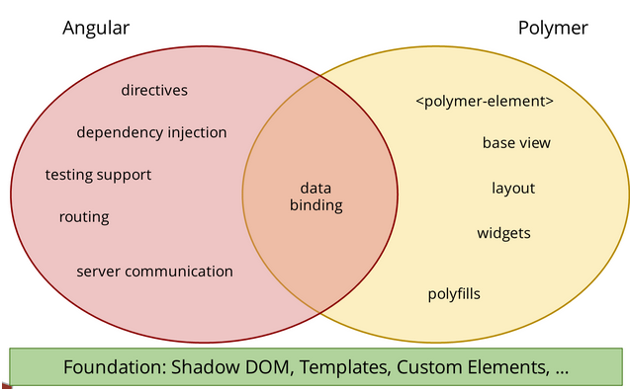
What to do with Dart?
A compelling use for Dart is client apps.
Powerful libraries for rich web apps:
Polymer
AngularDart
image source: Seth Ladd's blog
Notes:
http://blog.sethladd.com/2014/02/angular-and-polymer-data-binding.html
A compelling reason to use Dart is to write client apps. There are good libraries to help, namely Polymer and AngularDart.
Demo a sample client app made with AngularDart: https://www.dartlang.org/samples/angular_todo/
Other demos: https://www.dartlang.org/samples/

Slide 19
// thanks!
exit(0);
google.com/+BrocSeib
broc.seib@gmail.com
GLOSSY lightning-ish talks
Apr. 26, 2014
Notes:
Let me know if it should have been exit(2)!
dart code samples from these slides are here: https://github.com/bseib/LightningishDart

